Slide 1
Time Warrior By: Team BMP
Alex Beerman
Matthew Morrill
John Parks
Joe Ortega
Notes:
Introductions, Everyone introduce themselves

Slide 2
Roles
Group Member | Role(s) and Responsibilities
Alex Beerman | Lead Designer, Art Design, World Designer
Matthew Morrill | Project Manager, Co-designer
John Parks | Lead Programmer, Artist, Combat
Joe Ortega | Experience System
Notes:
Self-Introduction

Slide 3
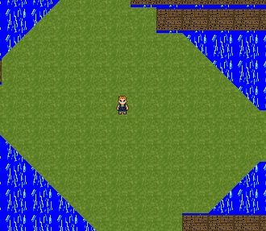
Time Warrior
Homage to Zelda, Diablo, Elder Scrolls
2D Action RPG
Fantasy Sci-fi
Notes:
Talk here about the plot. Alex talks elevator speech, Matt talks about plot.

Slide 4
Features
Day/Night cycle based on system time
Scripting Engine
24 Different skills
Dynamic Enemies
Multiple file save/loads
7 Different areas
Randomly picked dungeons
Everything Levels
Notes:
Day-Night : Alex, Scripting : Alex, Matt, Skills : John, Enemies : ALL, Save/Load : Matt, Areas : Alex, Dungeons : Alex
Speaking: Joe

Slide 5
Group Dynamics
Good Communication
Facebook
Commit Notes
Face to Face
No Conflicts
Code Meshed Well
Skill Levels Matched
Original 4th Member Left
Code Modified without Asking
Living Locations
Alex in San Mateo
Matt in Fremont
John in San Jose
Positives
Negatives
Notes:
Individual experiences later, only if ask…
John is speaking for most part.

Slide 6
Problems
Largely Complex Ideas
Sickness
Computer Issues
Low Networking Knowledge
No Dedicated Artist
Hard Delegation of Tasks
Deadlines Missed
Team Size = {4,3,2,1.5,4,2,3,2,3}
Notes:
Alex calls this slide

Slide 7
Alex Beerman
Started our entity class
Most things are based on entity
Designed the worlds
Art
World and most of the characters
Audio
Found someone do donate their music
Determined when and how to play the files
Minion/Boss Ai
Created the installer file
Notes:
Alex’s slide

Slide 8
Playable Characters
Hybrid : +1 Strength +1 Intellect
Caster : +2 Intellect
Tank : +2 Strength

Slide 9
Matthew Morrill
Started the scripting
Designed NPC’s, UI, HUD, World, Grid
Almost entirety of baseEngine
Second networking person
NBAI – Not Be An Idiot
Notes:
Matt’s Slide: RUN. LIKE HELL.

Slide 10
John Parks
Designed Chip, Armor, Magic, Weapon
Added Player’s Inventories
Armor Inv for Collected Armor
Attack Inv for Unlocked Magic & Weapons
Gauntlet Inv for Equipped Attacks & Armor
Gave Boss Ability to Use 3 Attacks
Worked with Entity & Chip Collision
Filled Out Other Classes
Notes:
John’s Slide

Slide 11
Joe Ortega
Notes:
Joe’s Slide

Slide 12
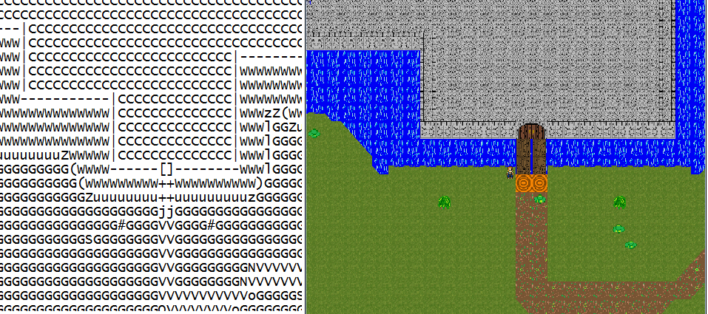
Map Comparisons
Notes:
Matt’s talking about this slide and scripting engine. Alex filled it out.

Slide 13
Inheritance Diagram
Entity
Chip
Player
NPC
Minion
Armor
Magic
Weapon
Boss
Divine
Ice
Blunt
Pierce
Slash
Range
Lightning
Fire

Slide 14
Controls
Key or Click | Purpose
W | Move Up
A | Move Left
S | Move Down
D | Move Right
Left Click | Activate 1st Attack, Select 1st Attack, Un/Equip Armor
Right Click | Activate 2nd Attack, Select 2nd Attack, Sell Armor
H | Use Health Potion (Heals ¼ Health)
E | Use Energy Potion (Regenerates ¼ Energy)
1-3, 5-7 | Change Left-click attack (1-3) or Right-click attack (5-7) to Basic, Advanced, or Expert version of that Attack
Space Bar | Activate NPC Dialogue (When in Range)

Slide 15

Skills - Magic
Divine | Lightning | Fire | Ice
Heal | Critical Chance | High Damage | Freeze DOT

Slide 16

Skills - Weapons
Blunt | Range | Slash | Pierce
Knockback | Projectile | High Damage | Critical Chance

Slide 17
Stats
Stat | Description | Relationship
Health | Hit Points | Inc. with Strength
Energy | Used for Attack Cost | Inc. with Intellect
Strength | Increases Weapon dmg | Inc. Health & Defense
Intellect | Increases Magic dmg | Inc. Energy & Resists
Defense | Combat with Weapons | Inc. with Strength
Fire Resistance | Combat w/Fire Magic | Inc. with Intellect
Ice Resistance | Combat w/Ice Magic | Inc. with Intellect
Lightning Resistance | Combat w/Lightning | Inc. with Intellect

Slide 18
Combat System
Material | Examples | Strong Against | Weak Against
Wood | flora, plants, vegetation | Ice | Fire
Fire | fire, magma, lava | Lightning | Ice
Earth | ground, mud, sand, rock | Lightning | Fire
Metal | metal, gold, silver | Ice | Lightning
Water | water, ice, water-vapor | Fire | Lightning
Air | gases, wind, lightning | Ice | Fire
Rubber | rubber, elastic, slime | Lightning | Ice
Light | light, heavenly, divine | Fire, Divine | Ice
Dark | dark, undead, shadows | Ice | Fire, Divine

Slide 19
Post-Mortem
Large World
Dynamic Enemies
Genre-specific Entertaining Gameplay
All Single-Player Skills
Multiplayer
Magic Combos
Shops
Different Quality of Skills
Original Ideas of Skills
Better AI
Extra Worlds
Did Get In
Did Not Get In
Notes:
EVERYONE IS SPEAKING

Slide 20
Future Plans
Get in Three Remaining Worlds
Functioning Multiplayer
Better Character Art
BALANCE!!!!!
Notes:
All is speaking

Slide 21
Demo and Questions
EST
U I
Q O
N
M
A
RK
Notes:
Everyone’s Speaking; FINAL SLIDE YAY

